Slide 1
Game design document for knock out
Knock out is an 1v1 local multiplayer
Brawler game

Slide 2
theme
2 guys got drunk and started to get into a fight in a bar

Slide 3
Target audience
12 years and up
Its violent with people punching each other until one of them goes k.o
Obviously it will attract kids younger then 12 because it has violence in it and kids love dumb violence

Slide 4
gameplay
The game plays like an local multiplayer 1v1 to be exact
The mechanics are that you got energy and your energy depletes with every punch you throw at someone if you run out of energy you lose but if you hit someone with your punch you win

Slide 5



Sprites/characters
Player 1
Player 2
walls

Slide 6
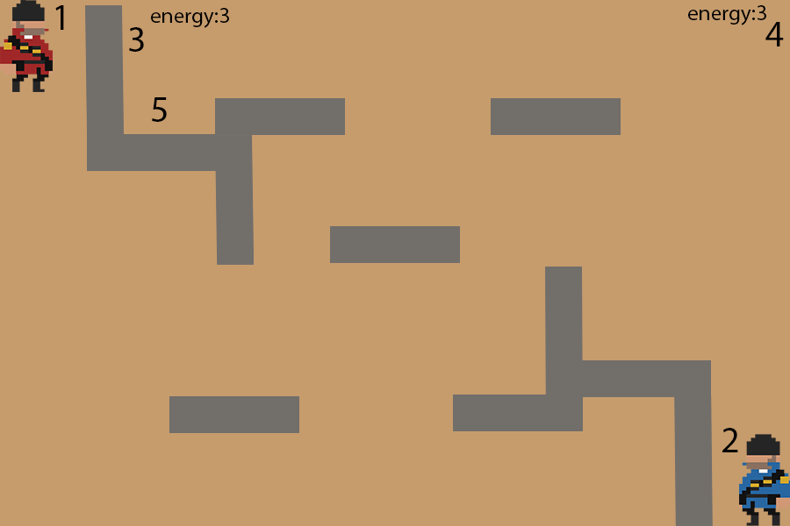
One of the levels in the game
As you can tell by the level to the right you got the 2 players marked with a 1 & 2
The energy counters
3 = player 1
4 = player 2
And last but not least the walls marked by an 5

Slide 7
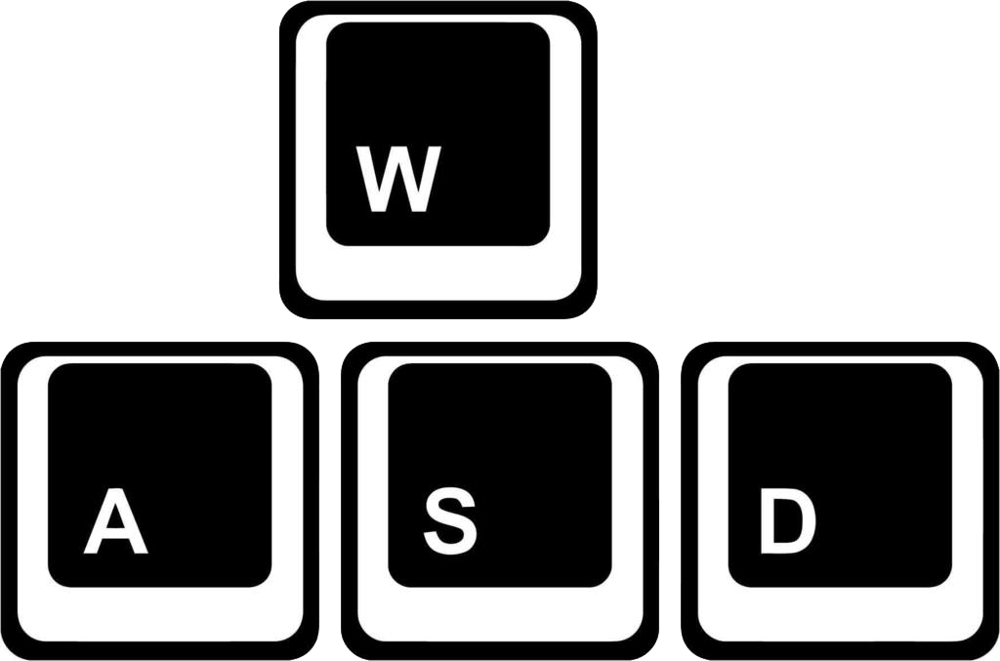
Controls player 1
W = forward/upward
A = left
S = backwards/downward
D = right

